Slide 1






Library Management System
SQL Project

Slide 2

Objective
The main objective of a Library Management System (LMS) SQL project is to create a comprehensive database-driven system that helps in managing the day-to-day operations of a library effectively and efficiently. The SQL aspect focuses on using a relational database to store, retrieve, update, and manage data related to books, users, checkouts, and other key aspects of library operations.

Slide 3
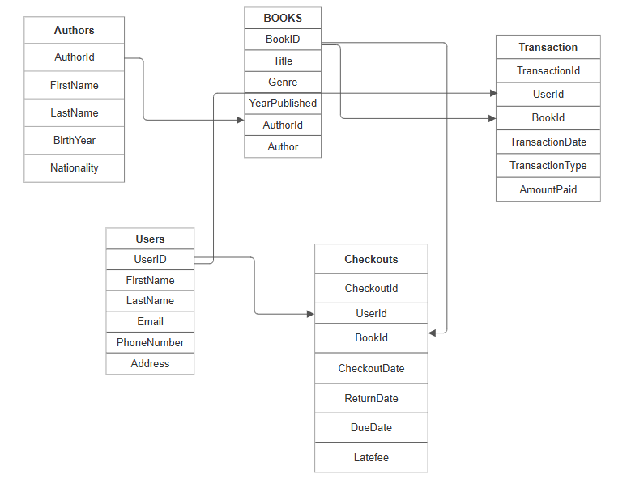
ER-Diagram

Slide 4




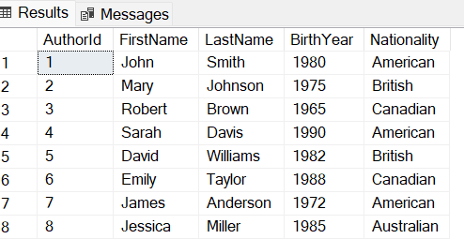

Creating Authors table
Syntax
Insert Values
Table
CREATE table authors(
AuthorId int,
FirstName varchar(50),
LastName varchar(50),
BirthYear int,
Nationality varchar(50)
);
Insert into authors (AuthorId,FirstName,LastName,BirthYear,Nationality) values
(1, 'John', 'Smith', 1980, 'American'),

Slide 5
Sample Queries
List all books published after the year 2015.
Show the number of available copies for each book.
Retrieve all users with email addresses that end in '@Yahoo.com'.
Find the total number of books checked out per genre.
Get the total late fee (based on days overdue) for overdue books.
Get the total number of books borrowed in the last month.
Update the contact details (email and phone number) for a specific user.

Slide 6





Total number of books borrowed in the last month
Query
SELECT
COUNT(*) AS TotalBooksBorrowed
FROM
Checkouts
WHERE
checkouts.CheckoutDate >= DATEADD(MONTH, -1, GETDATE());
Result

Slide 7

Conclusions
01
Efficient Book Management:
The system allows for easy tracking of books, their availability, and their status (whether they are available, checked out, or overdue). The process of adding, updating, or removing books from the system is automated, reducing the administrative burden.
02
Data-Driven Insights: The system can generate various reports that provide valuable insights into library usage, such as most borrowed books, popular genres, user activity, and overdue books. This data helps administrators optimize library operations and improve user experience.
03
User Management: By maintaining detailed records of users, the system enables efficient management of user information, including contact details, borrowing history, and current checkout statuses. It ensures that only registered users can borrow books and that their accounts are easily updated as needed.

Slide 8


Thank You

